Slide 1


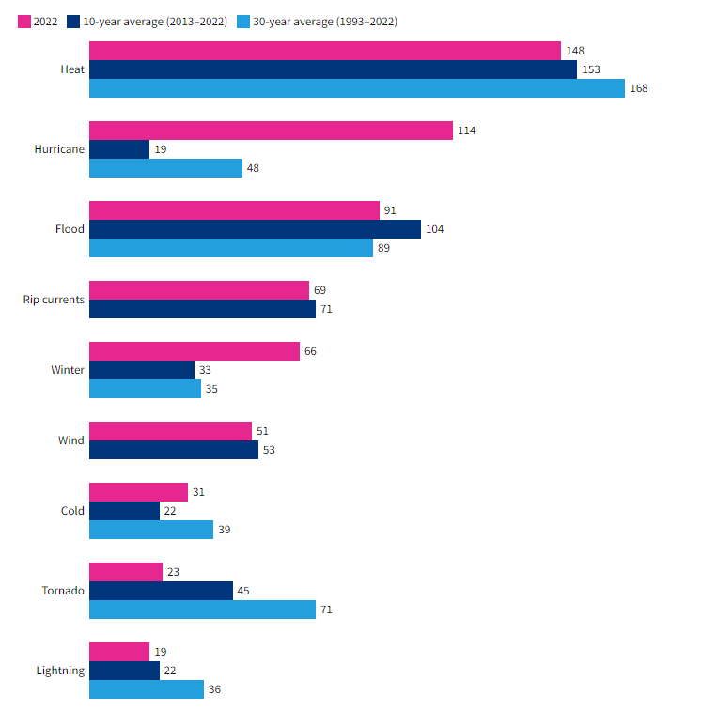
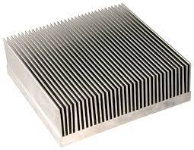
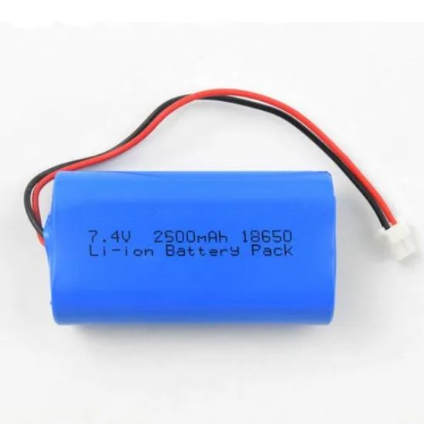
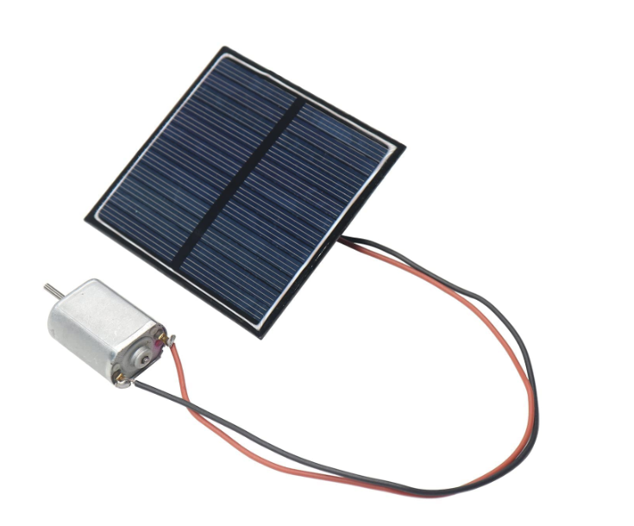
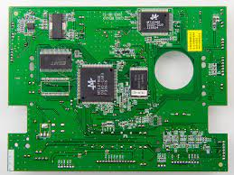
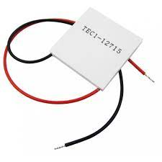
Team Name: UniAirs
Type: World’s Smallest Pocket Size AC
Model: Cool and Warm
Operating temperature range: -10 degree Celsius to +30 degree Celsius
Control: Smartphone application with Bluetooth connectivity
Power Input Method: USB Type C & Solar Panel
Battery type: Li – ion (2500mAh) upto 7 hours of backup
Weight: 136g (body) + 9g (neckband)
Material: Stainless Steel
Tech Stack
Micro-cooling Technology
Thermal Regulation System
User Interface
Printed Circuit Board
Energy Management System
Peltier Module
Cooling Components
Light Weight Materials
Uniqueness:
Pocket Size and Affordable
Solar Panel and Ecofriendly
Market Diversification
Efficient and Sustainable

Slide 2
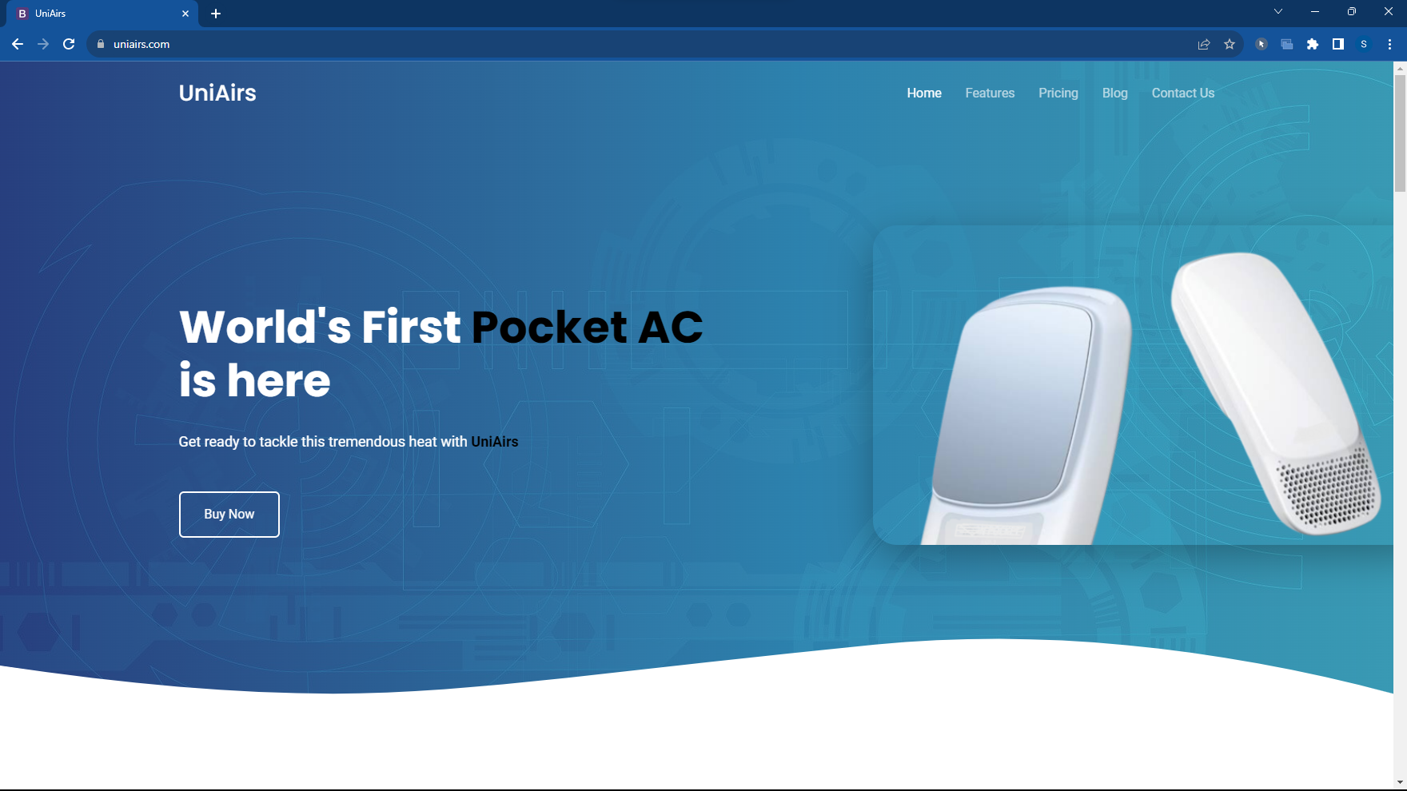


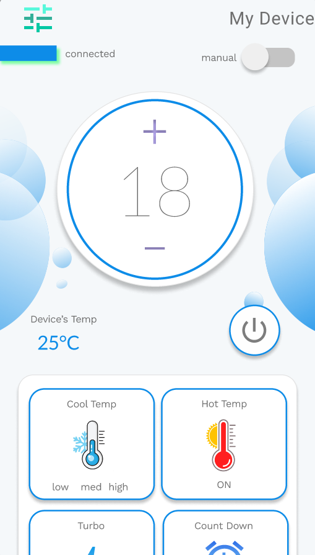
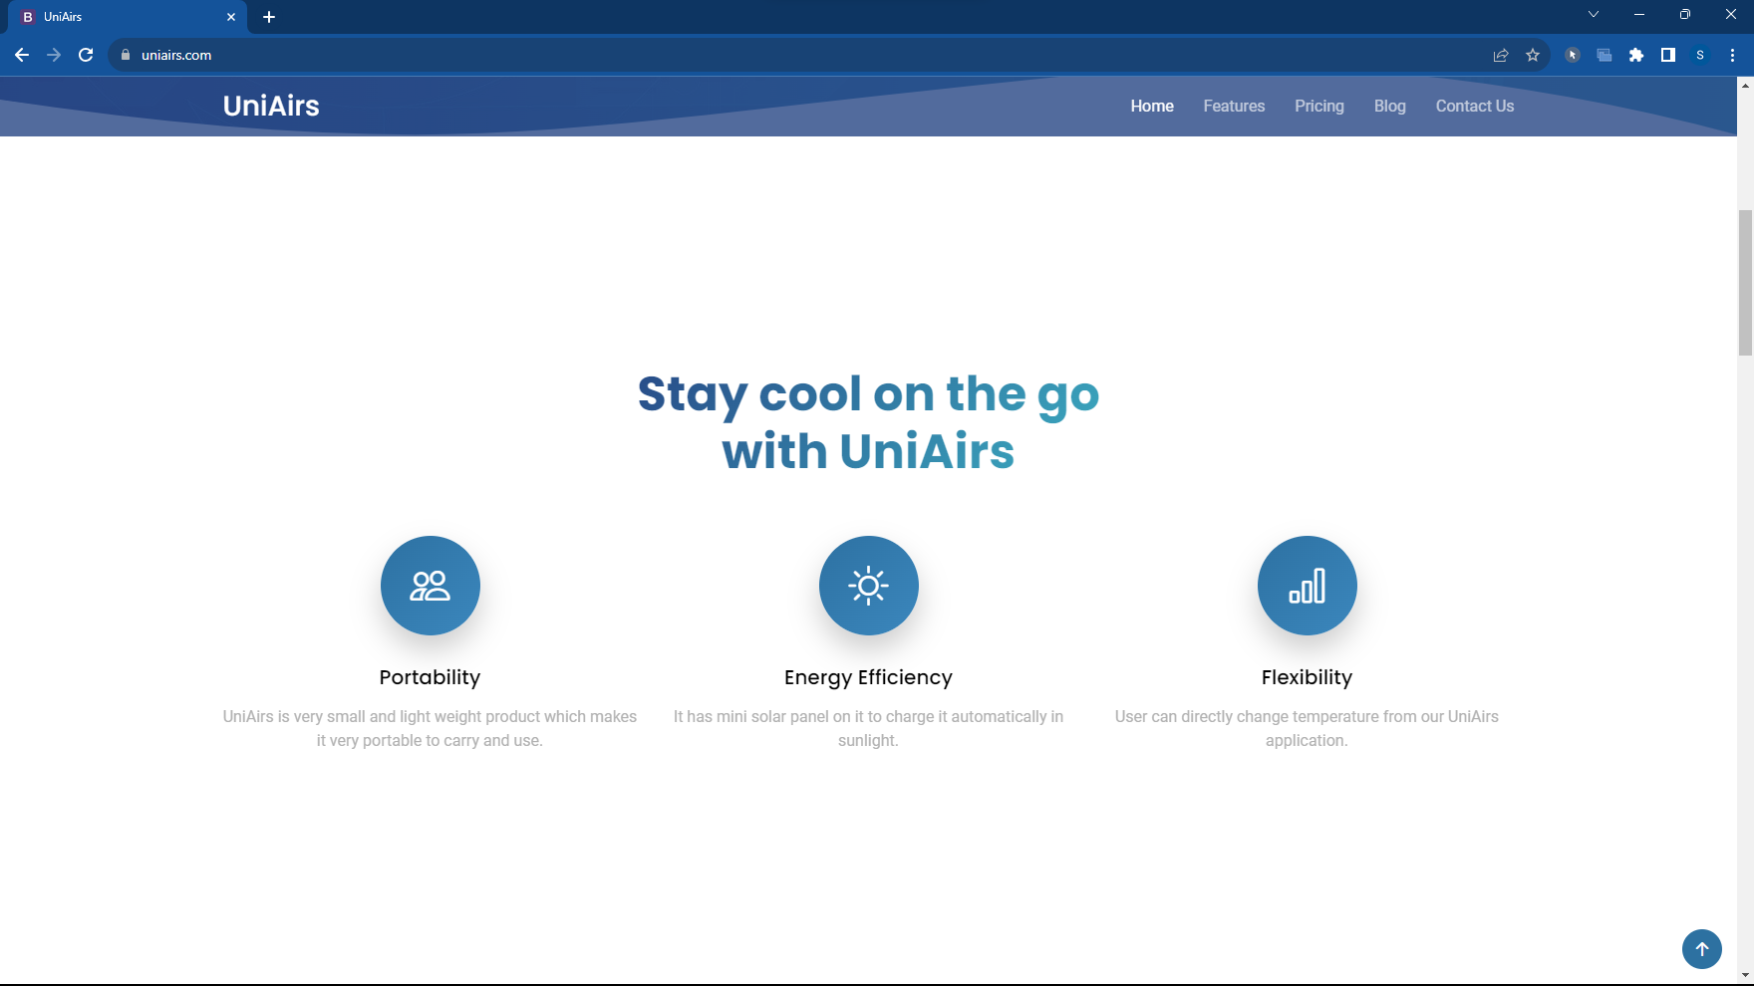
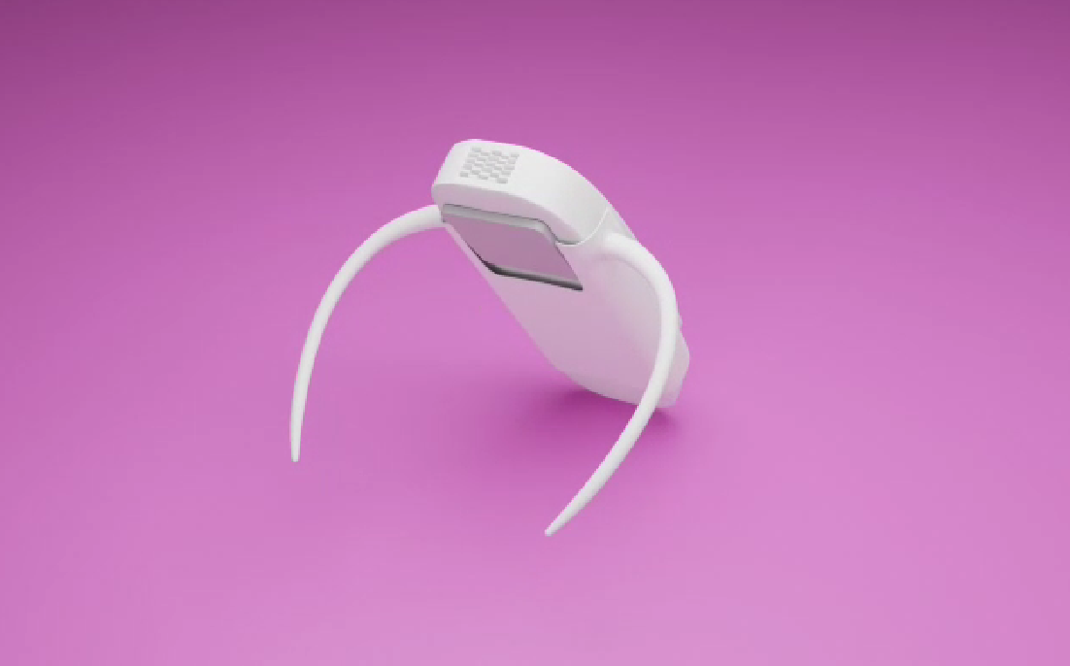
Design and Tech
Website (URL: www.uniairs.com)
For all the details of the product
UI/UX of Application
For Bluetooth connectivity and manual for user understanding
3D Model

